Slide 1
WEB 322 WEB PROGRAMMING TOOLS AND FRAMEWORKS
WEEK 1 - LECTURE 1
OVERVIEW OF THE WEB

Slide 2

What is the Internet
A global system of interconnected computer networks.
Devices use the TCP/IP protocol talk to other devices.

Slide 3
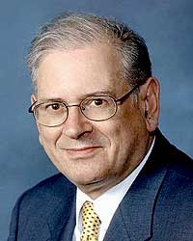
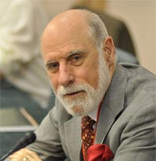
TCP/IP Protocol
Bob Kahn
Transmission Control Protocol/Internet Protocol
Developed in 1978 by Bob Kahn & Vint Cerf.
A set of rules that governs the connection of computer systems to the internet.
How information should be packaged (packets), sent, received, and routed.
Each device on the Internet has an IP address.
Vit Cerf

Slide 4

The World Wide Web (WWW) aka The Web
A “digital space” that is composed of billions connected electronic documents stored.
Hosted by web server software
Viewed by web browsers.
Based on a networking architecture called the Client-Server Model.
Created by Timothy Berners-Lee in 1989.
Also created the World Wide Web Consortium (W3C).
W3C oversees the continued development and standards of the Web.

Slide 5
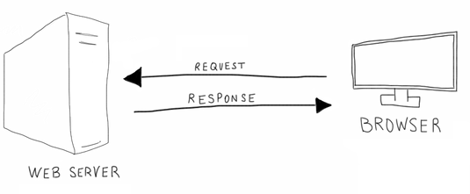
Client-Server Model
Server
Hosts one or more server programs.
Share resources with clients.
Waits for incoming requests from clients.
Client
Requests content from a server.
Initiates a communication session with a server.
Examples
Email
World Wide Web

Slide 6
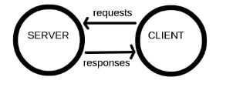
Hypertext Transfer Protocol (HTTP)
A client-server application-layer protocol designed for communication between web browsers and web servers.
Protocol: the official procedure or system of rules governing affairs of state or diplomatic occasions.
Hypertext: a word or words that contain a link to a website or webpage.

Slide 7
More of HTTP with respect to the web.
Clients and servers communicate by exchanging individual messages.
Messages are sent by the client, usually a web browser, these are called requests.
Servers answer client requests by sending a message back, these are called responses.

Slide 8

Restaurant Scenario
What rules must the wait staff and customer follow for the customer to get what they want?

Slide 9
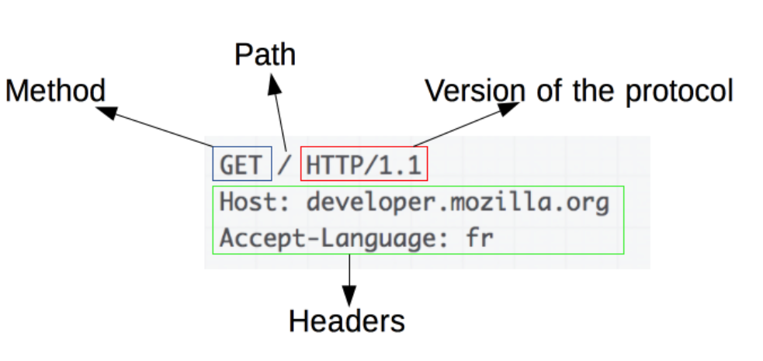
Making a Request
What’s in a Request?
A HTTP method such as GET, POST, PUT, or DELETE. This defines the operation the client wants to perform.
The path of the resource to grab.
The version of the HTTP protocol used.
Headers that convey additional information for the server.
A body (for some methods like POST).
Type in a URL in the address box of the browser
The browser translates the URL into a request message according to the HTTP protocol.
The request is sent to the destination server.

Slide 10
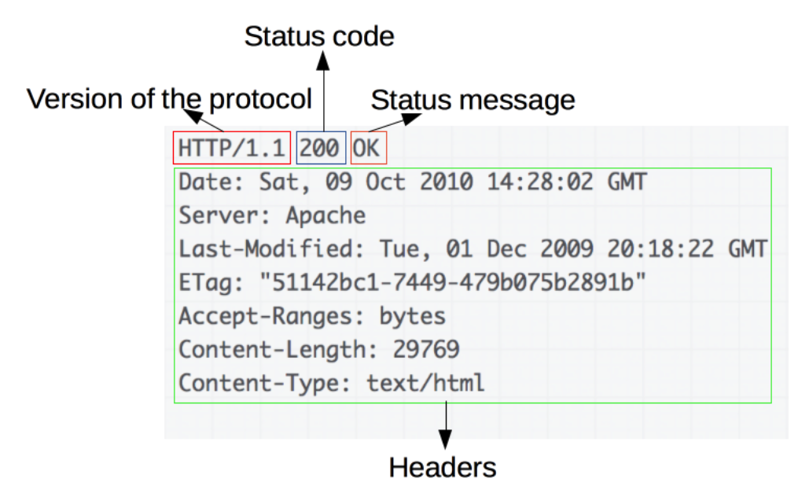
Responding to a Request
The server receives the request.
The request is interpreted.
A response is delivered to the client.
What’s in a Response?
The version of the HTTP protocol.
A status code: was the request successful or not? Why?
A status message: a non-authoritative short description of the status code.
HTTP headers, similar to a request.
A body containing the requested resource.

Slide 11
Types of Websites
Static Websites
Dynamic Websites
Single Page Applications

Slide 12
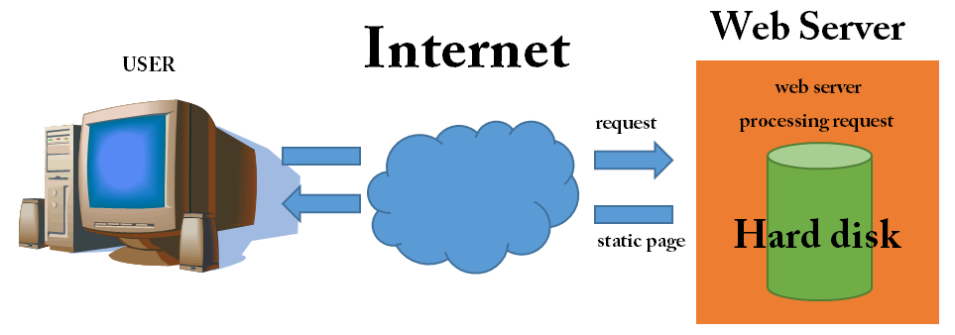
Static Websites
This is the oldest and simplest approach to building websites.
It is a website that returns the same hard-coded content and data from the server whenever a particular resource is requested.
These websites are not suitable for environments that require fast-changing content.

Slide 13
Dynamic Websites
A server generates the content of a website by pulling information from some source of data (on-the-fly).
Once constructed, the content is sent back to the client.
A downside: Users must wait for the web pages to be created on the server before they are sent back to the client.
Well suited for environments that require users of the site to generate their own data and for environments that require fast-changing content.

Slide 14
Single Page Application (SPA)
A modern approach to building websites.
If you click around, things happen instantly, once the page is loaded.
Inspired by mobile apps.

Slide 15
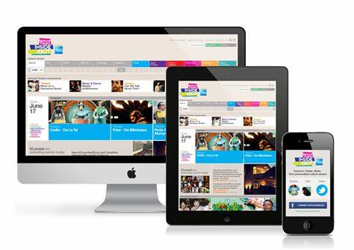
Responsive Design
A website’s design and development should respond to the user's environment based on screen size, platform and orientation.

Slide 16
Branches of web development
Front-End
Back-End
Full Stack

Slide 17
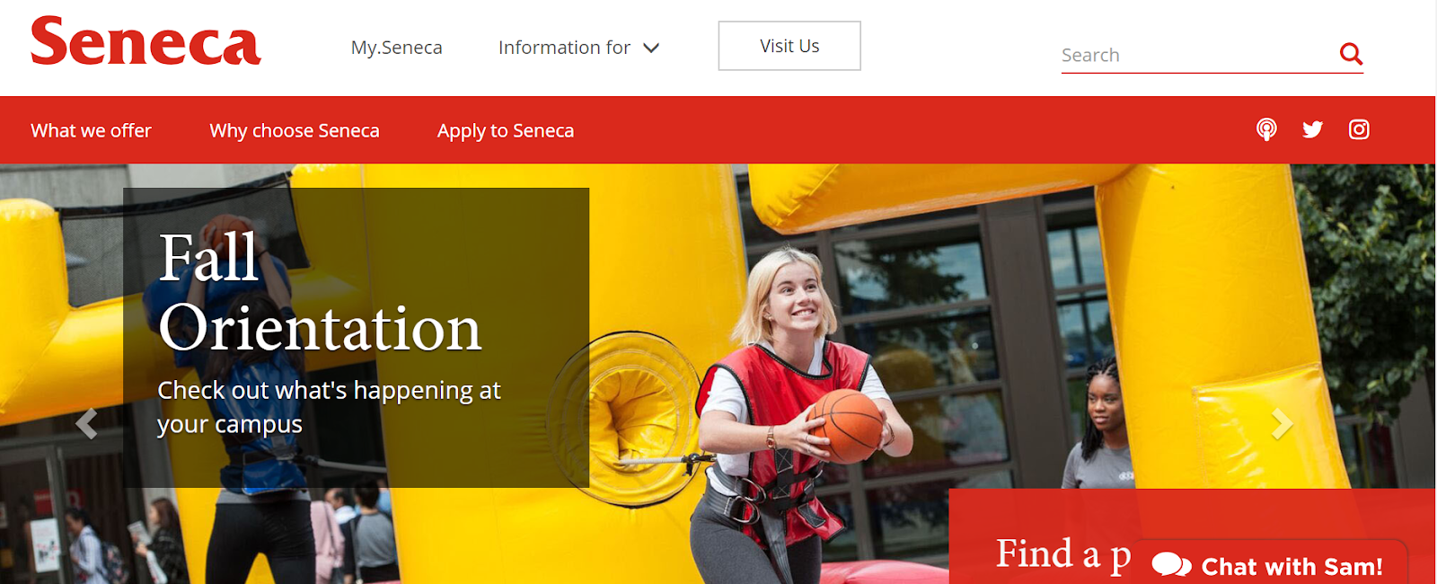
Front-End Web Development
The front-end of a website is the part that the users will see and interact with, in other words, the user interface that appears in the browser. The front-end is also known as the presentation layer.

Slide 18
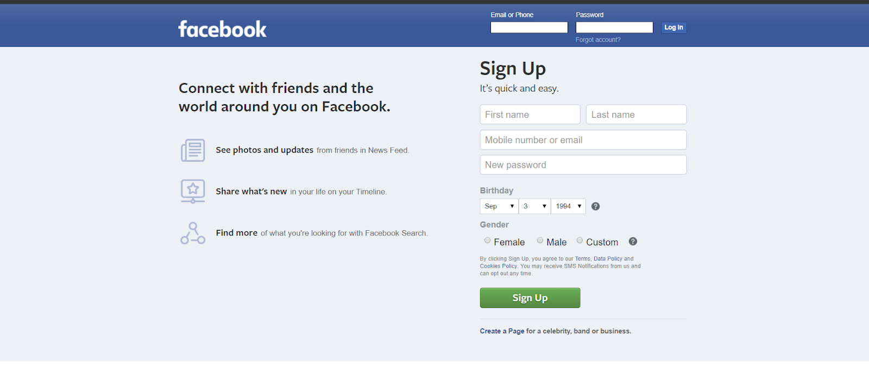
Back-End Web Development
The back-end is the part of the website that users don’t see. It refers to the server side, which is responsible for returning the page, and for storing or fetching user data.

Slide 19
Full-Stack Development
Full-stack development encompasses both front-end and back-end development work. Full-stack developer roles require a holistic view of every website, to find a full solution.
A developer in this position must know where (and how) to apply the various front-end and back-end technologies. They must be familiar with HTML, CSS and JavaScript, as well as a few popular backend languages. Many of them will specialize in one specific back-end language.

Slide 20
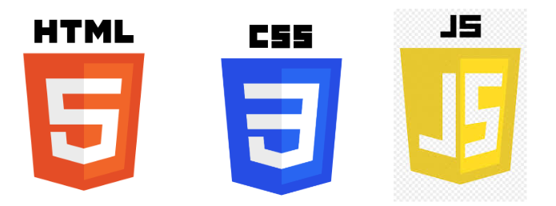
Front-End Technologies
HTML is used to set and define the structure of web page.
CSS is used to style the web page. It deals with the aesthetics of the website.
JavaScript is used to add interactivity to the interface of websites. With JavaScript your websites can perform arithmetic, user validation, timed image scrolling, animation, and more.
Vanilla JavaScript is JS without any library or framework.

Slide 21



JavaScript Frameworks
Promote modular and component based front-end code.
Use to build very interactive user interfaces.
You should learn at least one.
Example of JS Frameworks:
React - Most popular in the Industry
Vue - Gaining popularity
Angular - Used in enterprise development but losing steam.

Slide 22



CSS Frameworks
Makes your life easier and decrease the time it takes to build a user interface.
Good for prototyping
You should learn at least one.
Popular CSS Frameworks:
Bootstrap (The most popular of all the CSS Frameworks)
Materialize CSS
Bulma (A light-weight CSS framework, very easy to use)

Slide 23
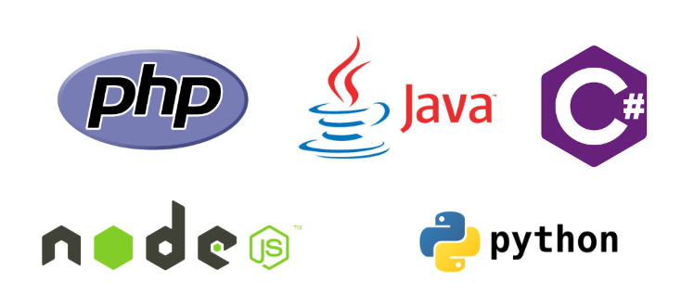
Some Back-End Technologies

Slide 24

Web Development Tools

Slide 25
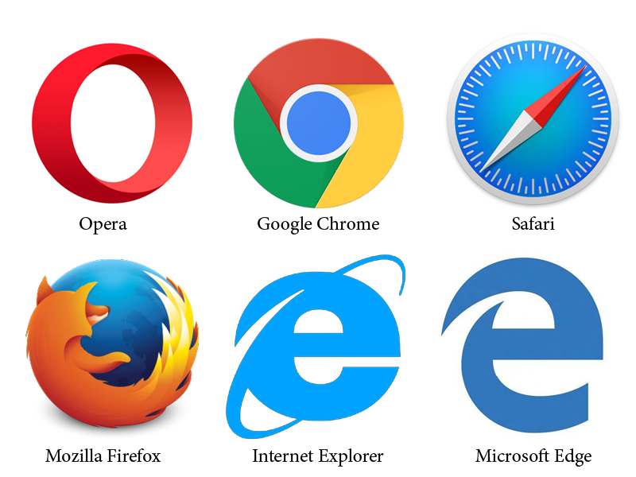

Web Browsers
A web browser is a software program that allows a user to locate, access, and display web pages.

Slide 26
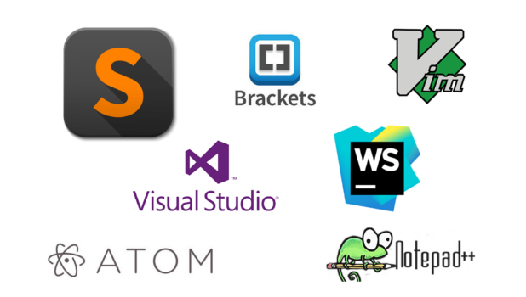
Code Editors

Slide 27


